Slide 1
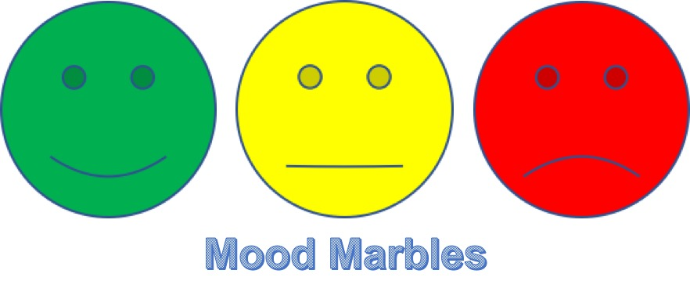
THINKDESK MOOD MARBLES
A Network Engineering Italy Market solution
Marco D’Agostino

Slide 2
WHAT IS
Is a simple solution developed to support the THINKDESK user’s feedback through the “Agile Mood Marble” practice.
It is designed to be worked on iPad (Landscape)
It is based on a mobile front-end and on IBM Cloud back-end

Slide 3
Anonymous
App doesn’t store any information related to the user, just the mood and comment provided by users therefore there is no privacy impact.

Slide 4
TECHNOLOGY

Slide 5
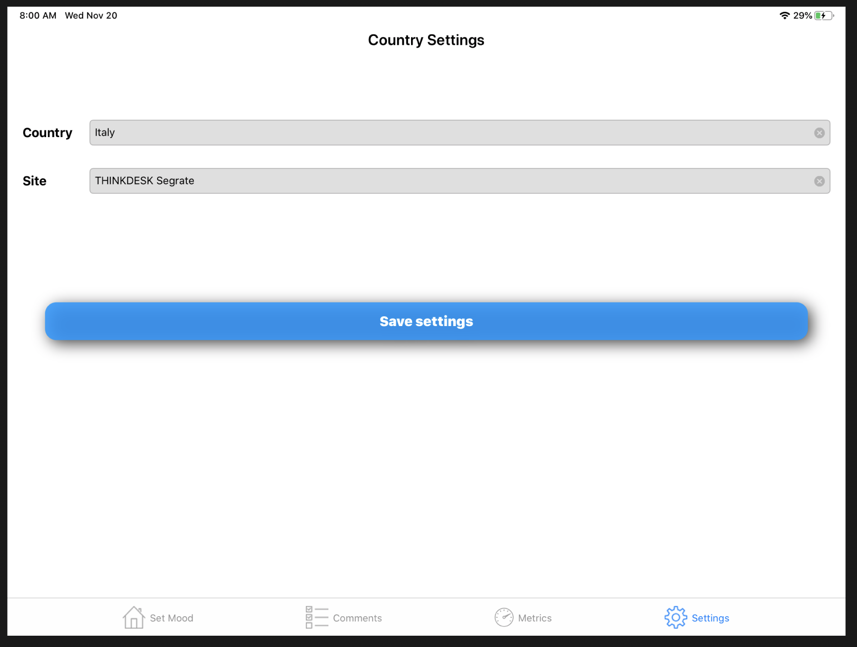
FIRST USE
The first time you launch mobile app you need to setup your profile by filling-in the identification of country and THINKDESK location (i.e. Italy, THINKDESK Segrate)

Slide 6
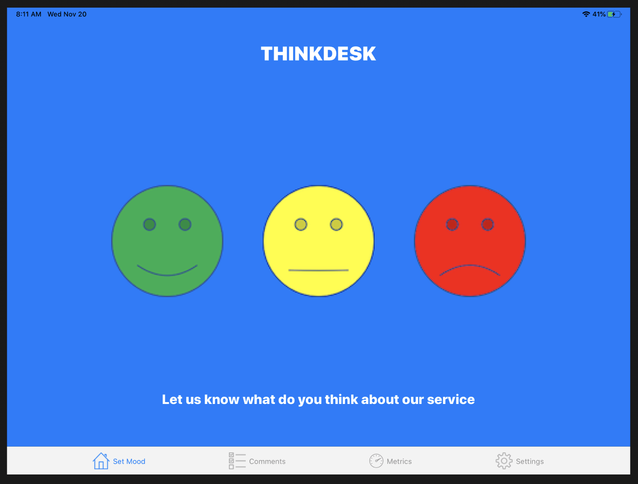
HOME SCREEN
The home screen let you the choice to let us know about your feeling on provided service.
Clicking on one of the “smiley” you’ll then registered the mood.

Slide 7
COMMENT SCREEN
To complete survey, a comment is requested. If not provided, the mood won’t be registered.

Slide 8
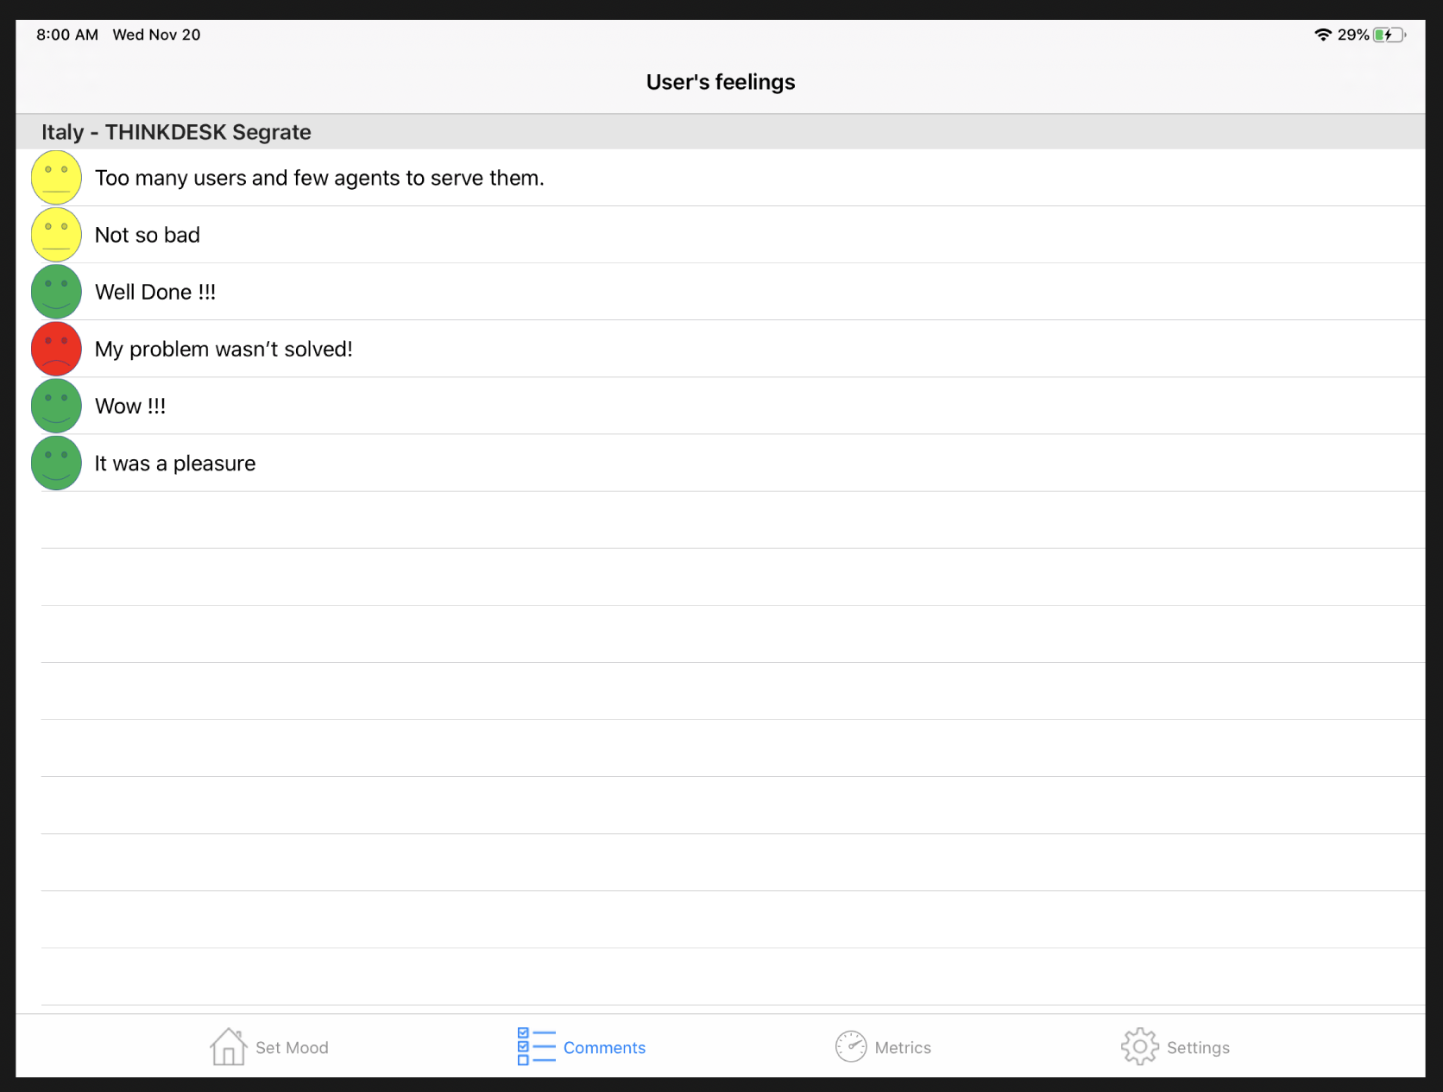
METRICS
A list of registered comments is available on a dedicated page.
Provided info are related to the last 30 days of activities therefore a trend should be maintained offline.

Slide 9
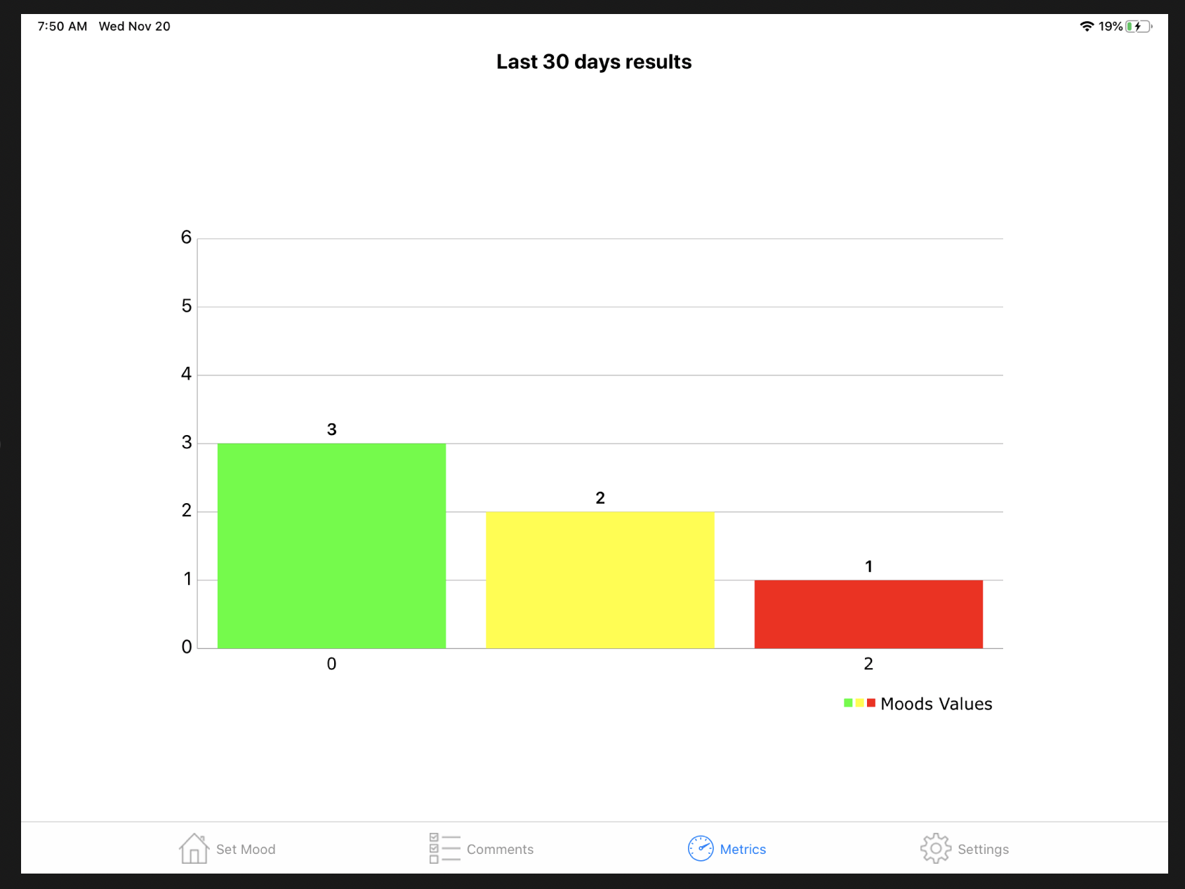
METRICS
At the same a graphical representation moods segmentation is also available.
Provided info are related to the last 30 days of activities therefore a trend should be maintained offline.

Slide 10
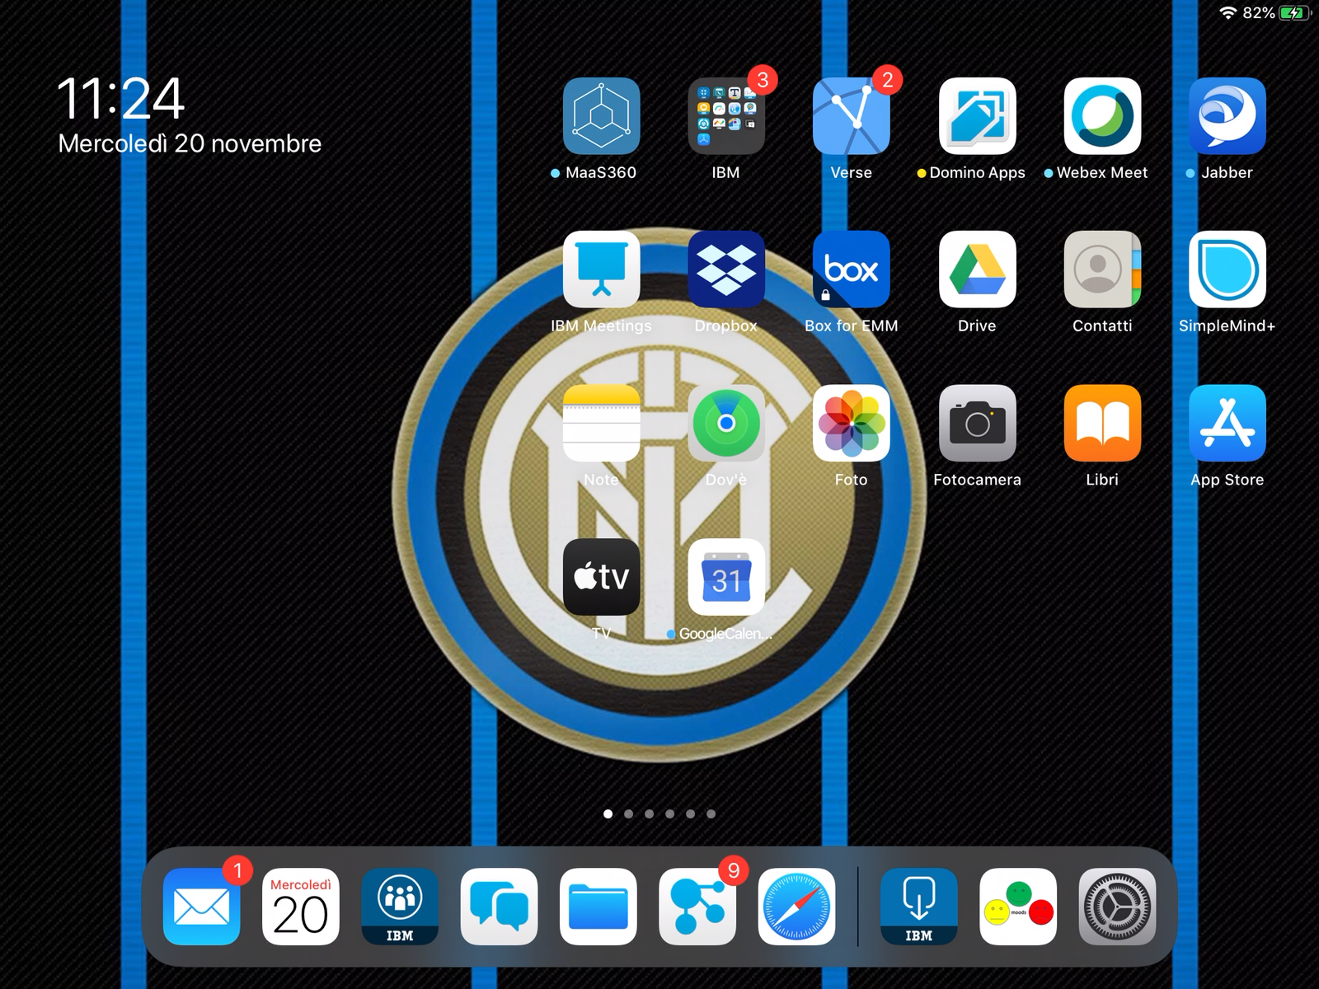
LIVE DEMO
Click on the picture to start live demo

Slide 11
Thanks

